Slide 1
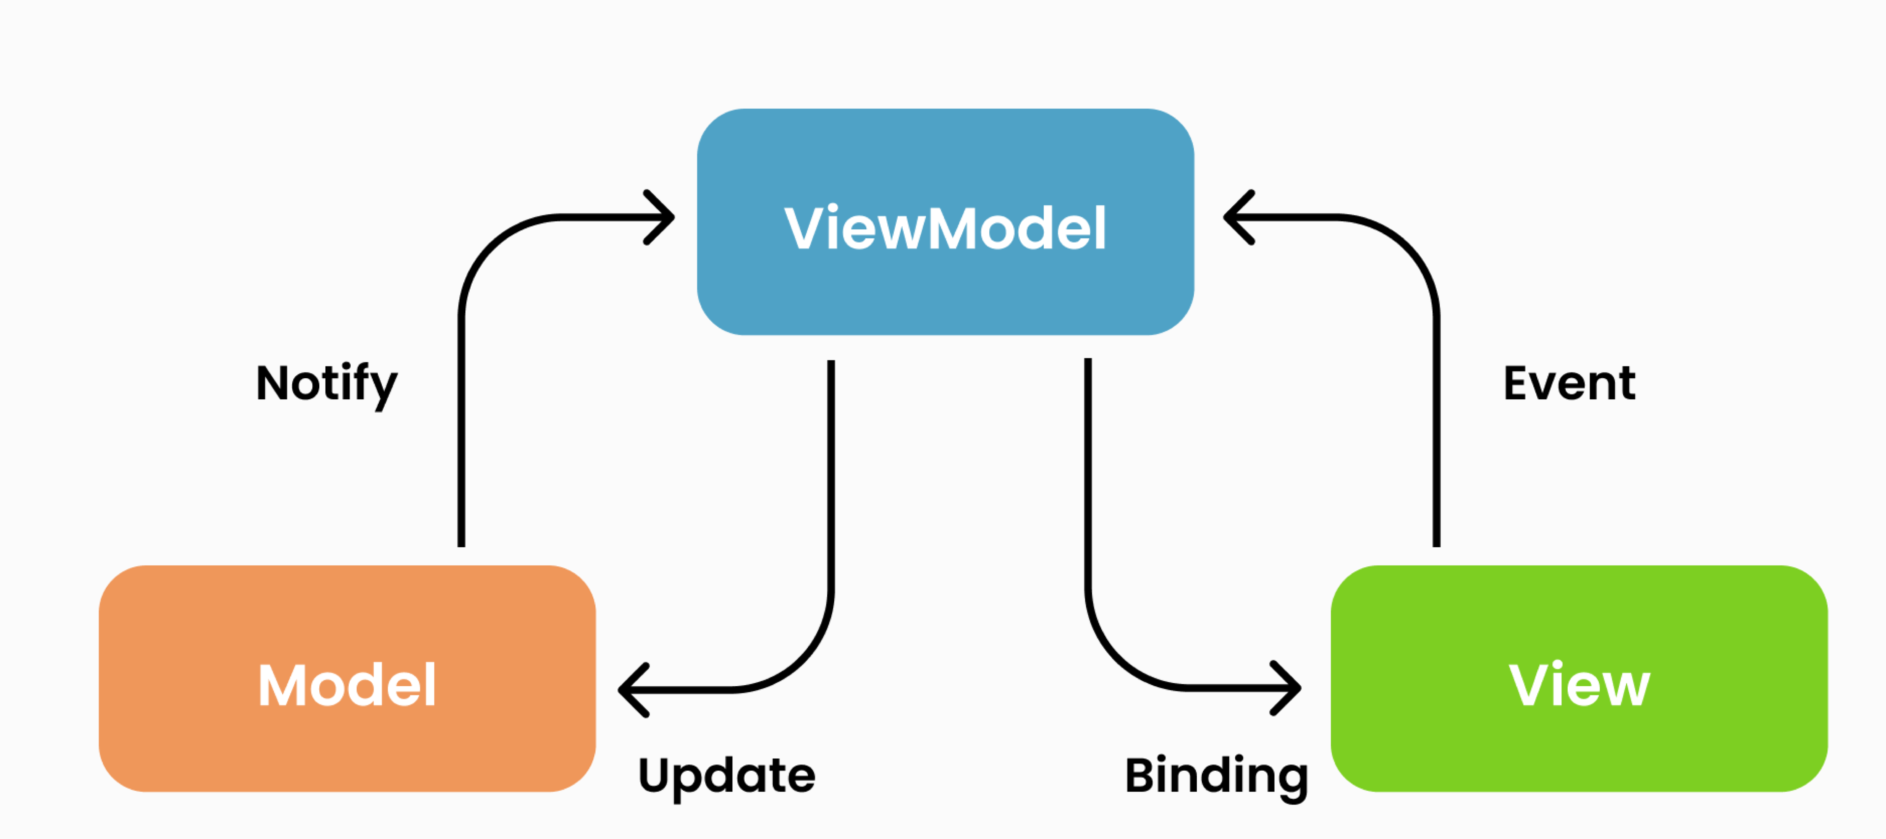
MVVM -
CLEAN ARCHITECTURE

Slide 2
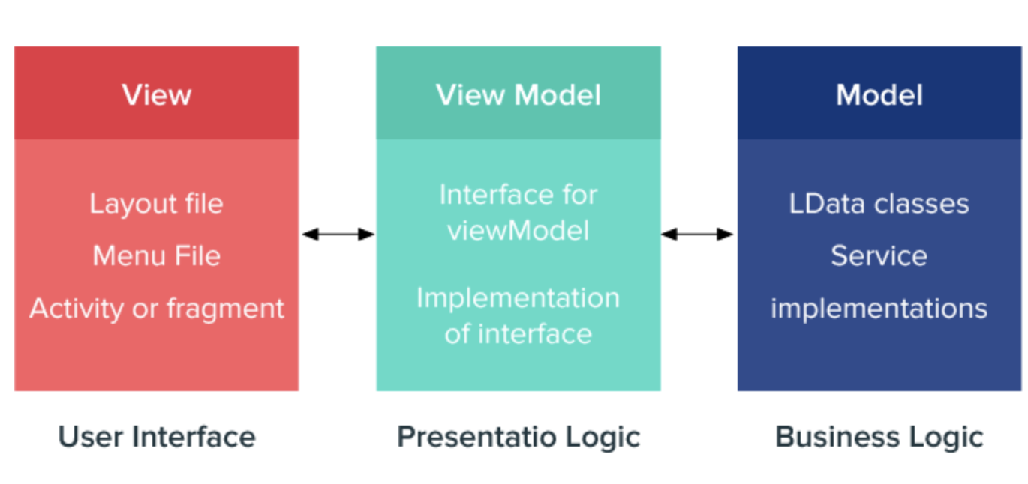
What is MVVM?
→ MODEL - VIEW - VIEWMODEL
→ a software design pattern
→ used to separate program logic and user interface
→ helps organize code and break programs into modules to make development, updating and reuse of code simpler and faster.
Notes:
The MVVM allows the Android app developers to use the concept of Data Binding with a reduced code that also provides a significant advantage in data connection.

Slide 3
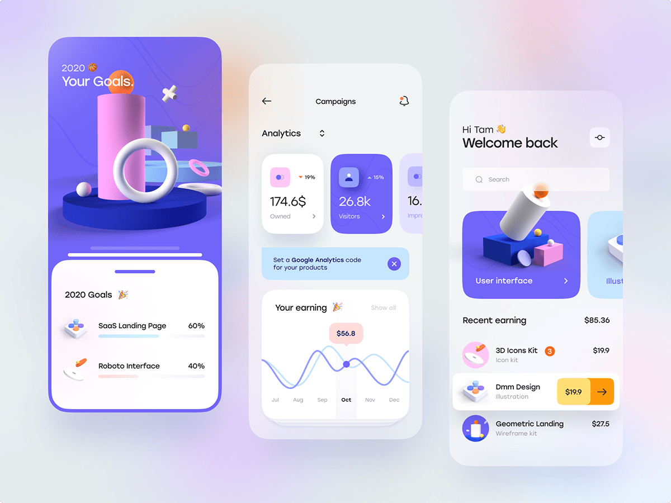
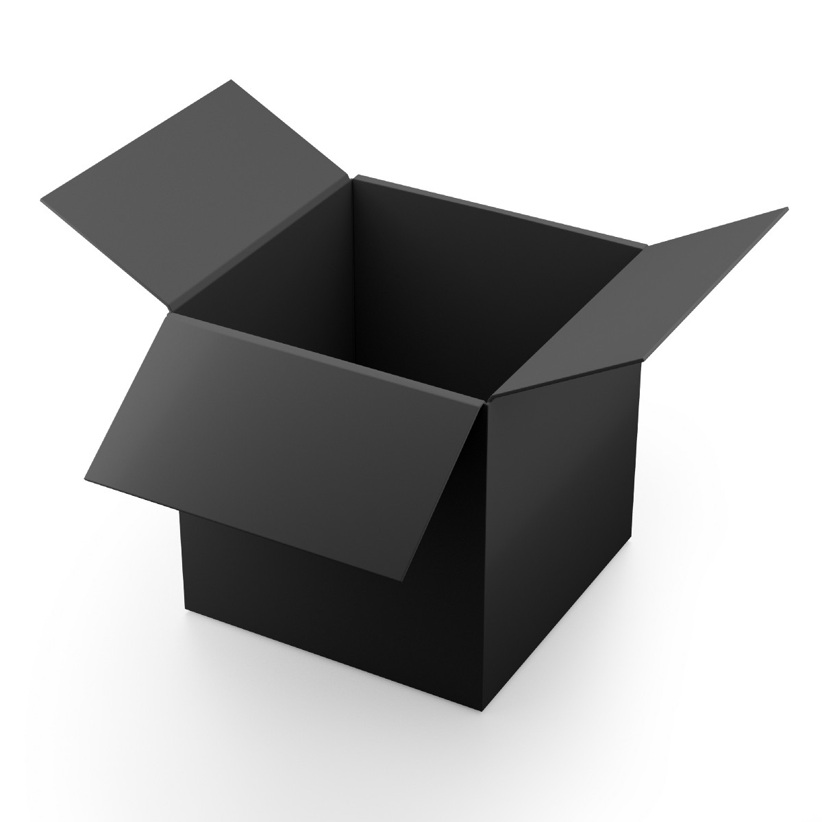
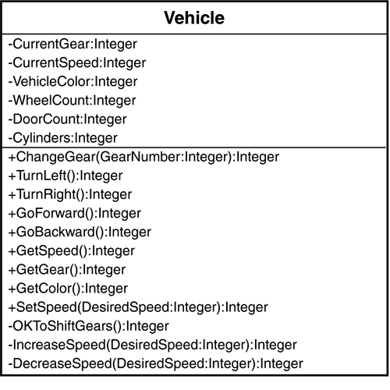
VIEW - VIEWMODEL - MODEL
View
→ Collection of visible elements
ViewModel
→ is located between the View and Model layers
→ this is where the controls for interacting with View are housed
Model
houses the logic for the program
is retrieved by the ViewModel when the user interacts with the UI (View)

Slide 4


SEPARATION OF CONCERNS
It's a common mistake to write all your code in an Activity or a Fragment
These UI-based classes should only contain logic that handles UI and operating system interactions
Remember, you don’t own implementations for Activity’s or Fragment’s, the operating system can come and destroy them at any time based on user interactions.
Activitys
Fragments

Slide 5
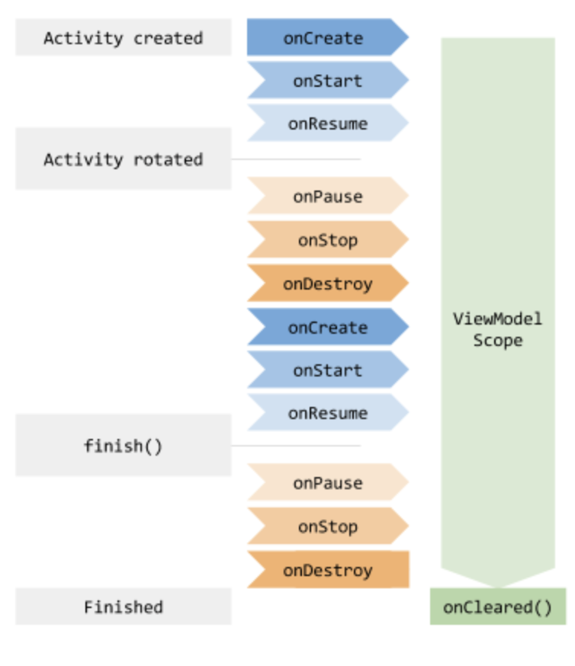
Activity lifecycle and ViewModel scope

Slide 6
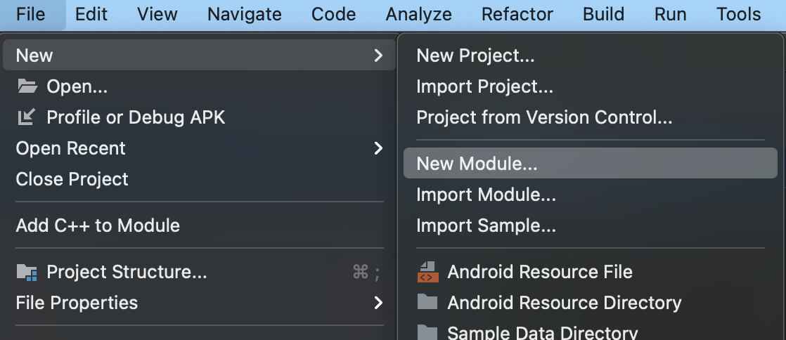
ANDROID LIBRARY
VS
JAVA LIBRARY
To create a new module we need to click on File → New → New Module…
We have two important library’s there:
- ANDROID LIBRARY → In which we have access to the Android context
- JAVA/KOTLIN LIBRARY → In which we can write the business logic of our app

